Slide 1



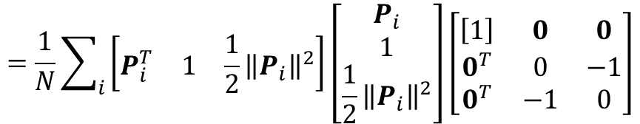
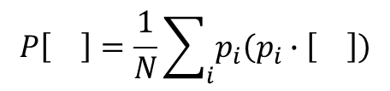
The linear operator of sphere fitting:
$$P\left[\right]=\frac{1}{N}\sum_{i}{p_{i}\left(p_{i}∙\left[\right]\right)}$$
$$=\frac{1}{N}\sum_{i}{\left[p_{i}\right]{\left[p_{i}\right]}^{T}\left[M\right]}$$
$$=\frac{1}{N}\sum_{i}{\left[\begin{matrix}P_{i}^{T} & 1 & \frac{1}{2}{\left\|P_{i}\right\|}^{2}\end{matrix}\right]\left[\begin{matrix}P_{i} \\ 1 \\ \frac{1}{2}{\left\|P_{i}\right\|}^{2}\end{matrix}\right]\left[\begin{matrix}\left[1\right] & 0 & 0 \\ 0^{T} & 0 & −1 \\ 0^{T} & −1 & 0\end{matrix}\right]}$$
1×5
5×1
5×5
$$∗Hadamard Product$$
$$Product$$

Slide 2




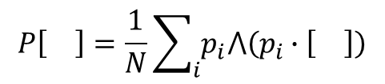


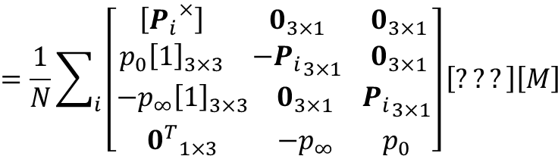



The linear operator of circle fitting:
$$P\left[\right]=\frac{1}{N}\sum_{i}{p_{i}⋀\left(p_{i}∙\left[\right]\right)}$$
$1. X$ is circle(bivector) : $p_{1}∧p_{2}∧p_{3} or s∧π or s∧s$
$${2. \left[P_{i}^{×}\right]}^{T}=−\left[P_{i}^{×}\right]$$
$$=\frac{1}{N}\sum_{i}{\left[p_{i}^{∧}\right]\left(\left[???\right]\left[M\right]\left[\right]\right)}$$
$$3. { p}_{i}∙X=\left(p_{i}∙s\right)π−\left(p_{i}∙π\right)s$$
What is it? And How to get it??
$$5×10$$
$$10×10$$
$$=\frac{1}{N}\sum_{i}{\left[\begin{matrix}\begin{matrix}\left[{P_{i}}^{×}\right] & 0_{3×1} & 0_{3×1} \\ p_{0}{\left[1\right]}_{3×3} & {−P_{i}}_{3×1} & 0_{3×1}\end{matrix} \\ \begin{matrix}−p_{∞}{\left[1\right]}_{3×3} & 0_{3×1} & {P_{i}}_{3×1} \\ {0^{T}}_{1×3} & −p_{∞} & p_{0}\end{matrix}\end{matrix}\right]\left[???\right]\left[M\right]}$$
$$10×5$$
$$5×10$$
$$product$$
$$product$$

Slide 3

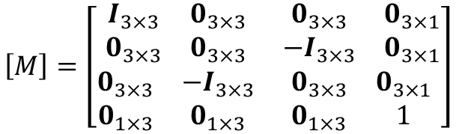
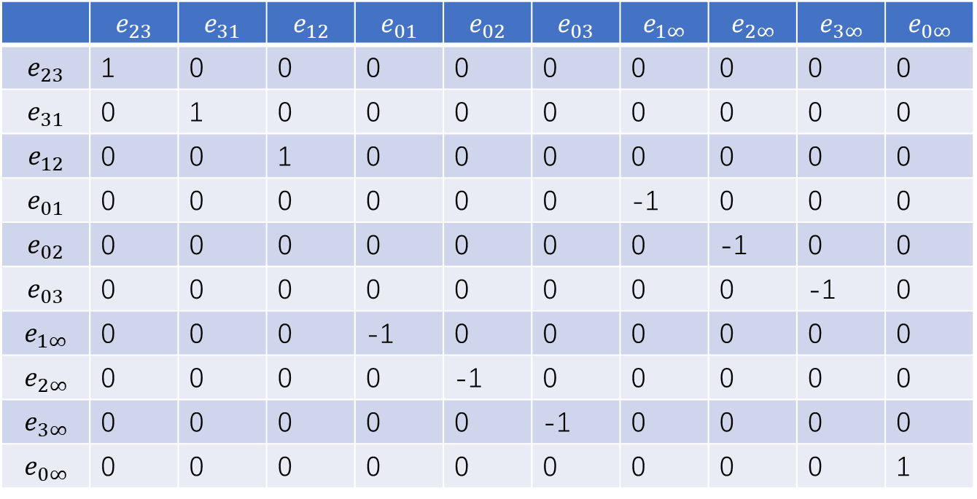
calculate $\left[M\right]$
$$basis of X:\left\{e_{23},e_{31},e_{12}丨e_{01},e_{02},e_{03}丨e_{1∞},e_{2∞},e_{3∞}丨e_{0∞}\right\}$$
 | $$e_{23}$$ | $$e_{31}$$ | $$e_{12}$$ | $$e_{01}$$ | $$e_{02}$$ | $$e_{03}$$ | $$e_{1∞}$$ | $$e_{2∞}$$ | $$e_{3∞}$$ | $$e_{0∞}$$
$$e_{23}$$ | 1 | 0 | 0 | 0 | 0 | 0 | 0 | 0 | 0 | 0
$$e_{31}$$ | 0 | 1 | 0 | 0 | 0 | 0 | 0 | 0 | 0 | 0
$$e_{12}$$ | 0 | 0 | 1 | 0 | 0 | 0 | 0 | 0 | 0 | 0
$$e_{01}$$ | 0 | 0 | 0 | 0 | 0 | 0 | -1 | 0 | 0 | 0
$$e_{02}$$ | 0 | 0 | 0 | 0 | 0 | 0 | 0 | -1 | 0 | 0
$$e_{03}$$ | 0 | 0 | 0 | 0 | 0 | 0 | 0 | 0 | -1 | 0
$$e_{1∞}$$ | 0 | 0 | 0 | -1 | 0 | 0 | 0 | 0 | 0 | 0
$$e_{2∞}$$ | 0 | 0 | 0 | 0 | -1 | 0 | 0 | 0 | 0 | 0
$$e_{3∞}$$ | 0 | 0 | 0 | 0 | 0 | -1 | 0 | 0 | 0 | 0
$$e_{0∞}$$ | 0 | 0 | 0 | 0 | 0 | 0 | 0 | 0 | 0 | 1
$$\left[M\right]=\left[\begin{matrix}\begin{matrix}I_{3×3} & 0_{3×3} \\ 0_{3×3} & 0_{3×3}\end{matrix} & \begin{matrix}0_{3×3} & 0_{3×1} \\ −I_{3×3} & 0_{3×1}\end{matrix} \\ \begin{matrix}0_{3×3} & −I_{3×3} \\ 0_{1×3} & 0_{1×3}\end{matrix} & \begin{matrix}0_{3×3} & 0_{3×1} \\ 0_{1×3} & 1\end{matrix}\end{matrix}\right]$$

Slide 4
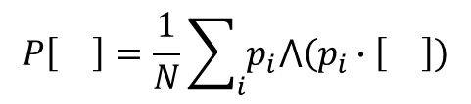
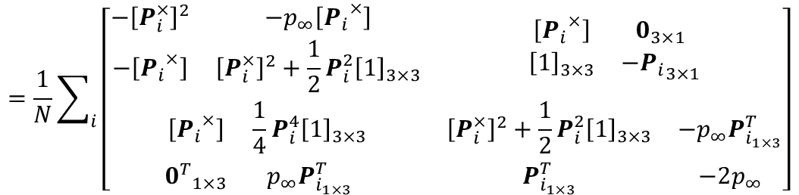

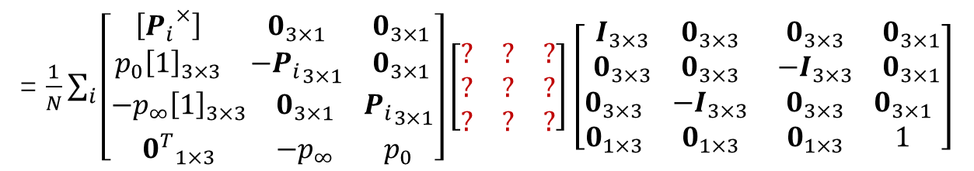




$$P\left[\right]=\frac{1}{N}\sum_{i}{p_{i}⋀\left(p_{i}∙\left[\right]\right)}$$
$$=\frac{1}{N}\sum_{i}{\left[p_{i}^{∧}\right]\left(\left[???\right]\left[M\right]\left[\right]\right)}$$
= $\frac{1}{N}\sum_{i}{\left[\begin{matrix}\begin{matrix}\left[{P_{i}}^{×}\right] & 0_{3×1} & 0_{3×1} \\ p_{0}{\left[1\right]}_{3×3} & {−P_{i}}_{3×1} & 0_{3×1}\end{matrix} \\ \begin{matrix}−p_{∞}{\left[1\right]}_{3×3} & 0_{3×1} & {P_{i}}_{3×1} \\ {0^{T}}_{1×3} & −p_{∞} & p_{0}\end{matrix}\end{matrix}\right]\left[\begin{matrix}? & ? & ? \\ ? & ? & ? \\ ? & ? & ?\end{matrix}\right]\left[\begin{matrix}\begin{matrix}I_{3×3} & 0_{3×3} \\ 0_{3×3} & 0_{3×3}\end{matrix} & \begin{matrix}0_{3×3} & 0_{3×1} \\ −I_{3×3} & 0_{3×1}\end{matrix} \\ \begin{matrix}0_{3×3} & −I_{3×3} \\ 0_{1×3} & 0_{1×3}\end{matrix} & \begin{matrix}0_{3×3} & 0_{3×1} \\ 0_{1×3} & 1\end{matrix}\end{matrix}\right]}$
$$10×5$$
$$5×10$$
$$10×10$$
What is it? And How to get it??
$$=\frac{1}{N}\sum_{i}{\left[\begin{matrix}\begin{matrix}{−\left[P_{i}^{×}\right]}^{2} & −p_{∞}\left[{P_{i}}^{×}\right] \\ −\left[{P_{i}}^{×}\right] & {\left[P_{i}^{×}\right]}^{2}+\frac{1}{2}P_{i}^{2}{\left[1\right]}_{3×3}\end{matrix} & \begin{matrix}\left[{P_{i}}^{×}\right] & 0_{3×1} \\ {\left[1\right]}_{3×3} & {−P_{i}}_{3×1}\end{matrix} \\ \begin{matrix}\left[{P_{i}}^{×}\right] & \frac{1}{4}P_{i}^{4}{\left[1\right]}_{3×3} \\ {0^{T}}_{1×3} & p_{∞}P_{i_{1×3}}^{T}\end{matrix} & \begin{matrix}{\left[P_{i}^{×}\right]}^{2}+\frac{1}{2}P_{i}^{2}{\left[1\right]}_{3×3} & −p_{∞}P_{i_{1×3}}^{T} \\ P_{i_{1×3}}^{T} & −2p_{∞}\end{matrix}\end{matrix}\right]}$$
$$The result: 10×10matrix of \left[P^{′}\right]$$

